Slide 1
Deep Learning: -- convolutional neural network for image classification
Yifei Huang
2017/08/06

Slide 2
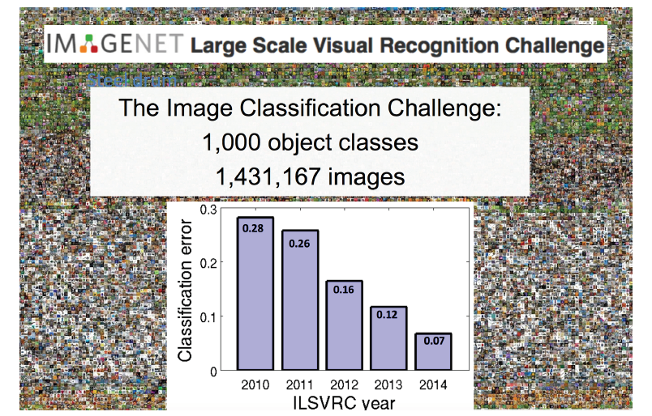
What Happened In The Year of 2012?

Slide 3
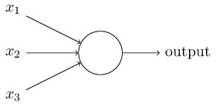
What Is a Neuron?
Linear combination + non-linear activation
H = W*X +b
A = activation_function(H)
W1
+b
W2
Activation
H
A
W3

Slide 4
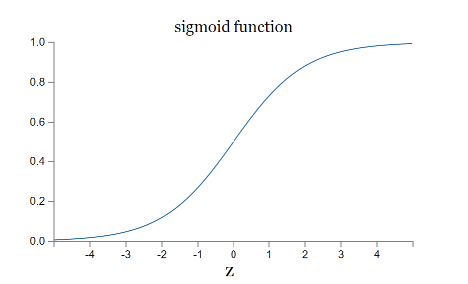
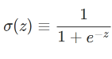
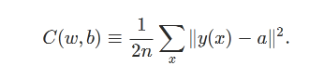
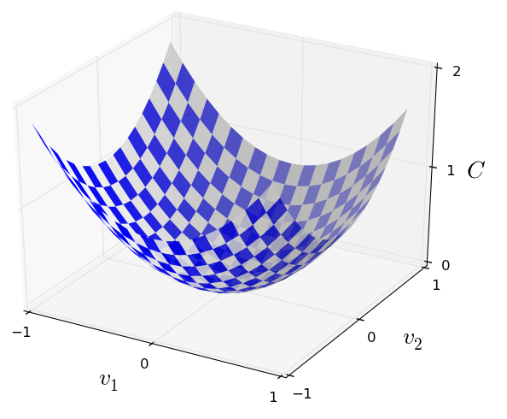
How To Train A Neuron?
Define a Loss function
Gradient Descent to update model parameters (W)
Loss = C(y, y_)
y = activation_cuntion(H)
H = linear_combination(W, X, b)
Update W based on the descent direction of dL/dW
W➔ W – learning_rate * dL/dW
b➔ b- learning_rate *dL/db

Slide 5
Limitation of a Neuron
Linear separator
Can not handle a XOR function
Wee need more neural layers.
:(
:)

Slide 6
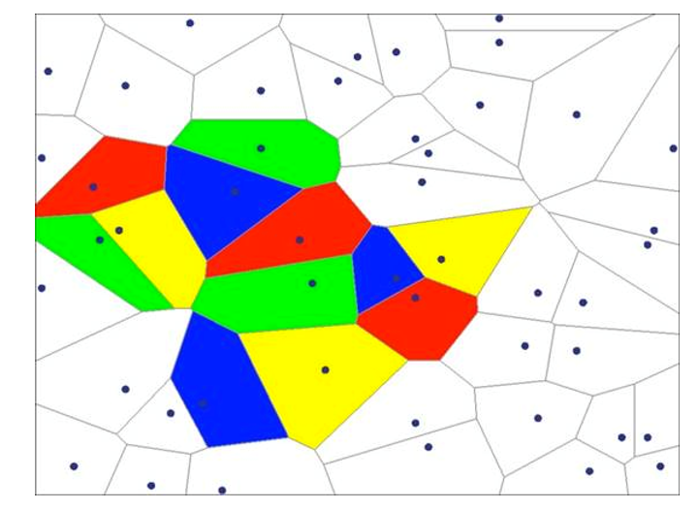
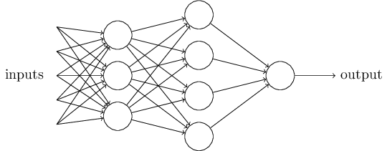
Why a Multi Layer Neural Network Can Predict Anything?
For classification
For regression:
http://neuralnetworksanddeeplearning.com/chap4.html
Linear Separator
And
OR

Slide 7
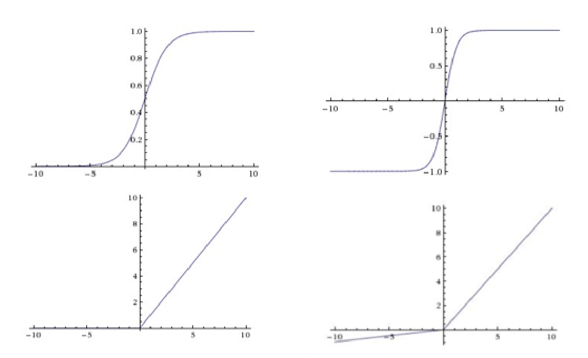
Why we need an non-linear activation function?
Sigmoid
Transfer from [-inf, + inf] ➔ [0, 1], probability
Works as a switcher, pass the signal if > 0
Multi Linear Layers
equivalent one Linear Layer
Different activation functions used:
Sigmoid
Tanh
RELU
Leaky-RELU
Y = 1/(1+exp(-x))
Y = (exp(x) – exp(-x)) /(exp(x)+exp(-x))
Sigmoid
Tanh
RELU
Leaky-RELU
Y = max(0, x)
Y = max(a*x, x)

Slide 8
Build Your Own Neural Network!
http://playground.tensorflow.org

Slide 9


Slide 10
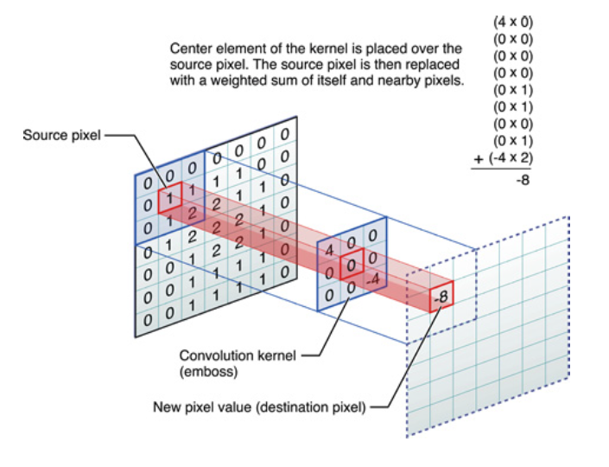
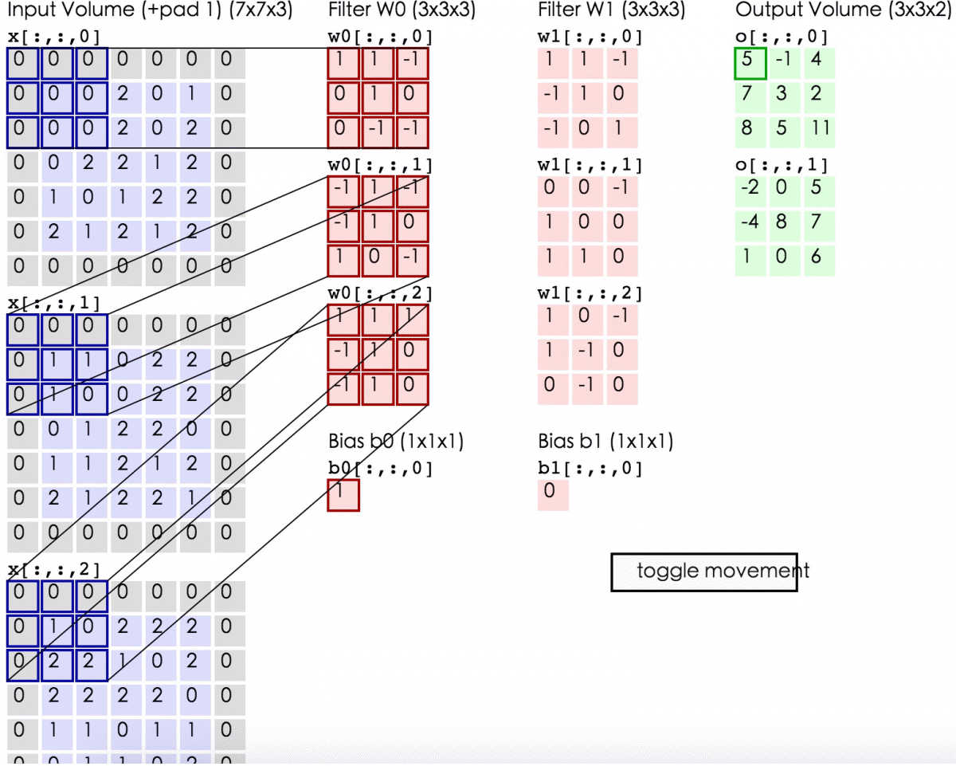
Convolutional Layer

Slide 11
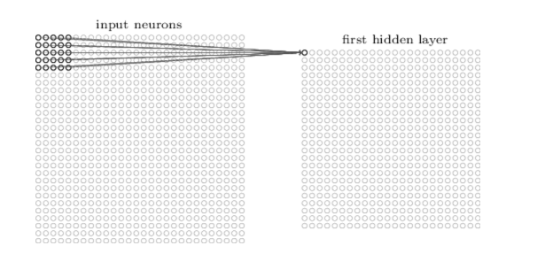
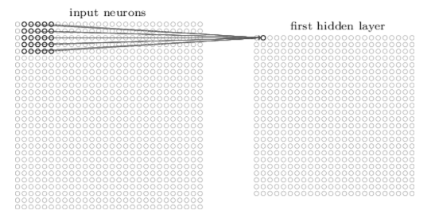
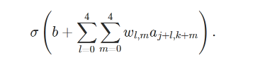
Convolution Neural Network

Slide 12
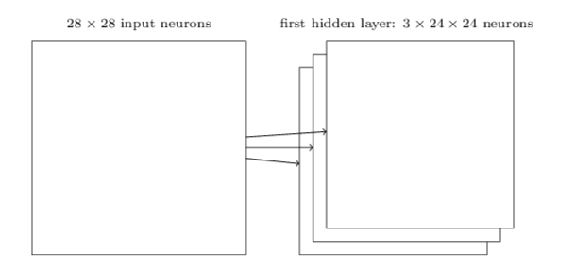
Quiz
Kernel size? Kernel number? Stride? Variables number to learn?
Kernel size: 5*5, no padding, stride = 1, kernel count: 3
Variable count: 5*5*3 +3

Slide 13
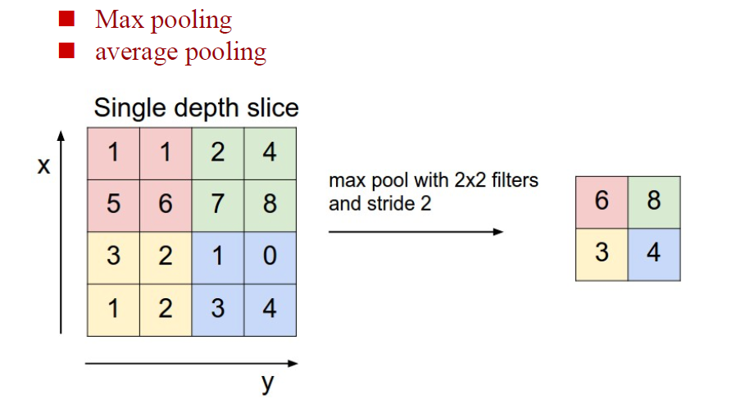
Pooling layer

Slide 14
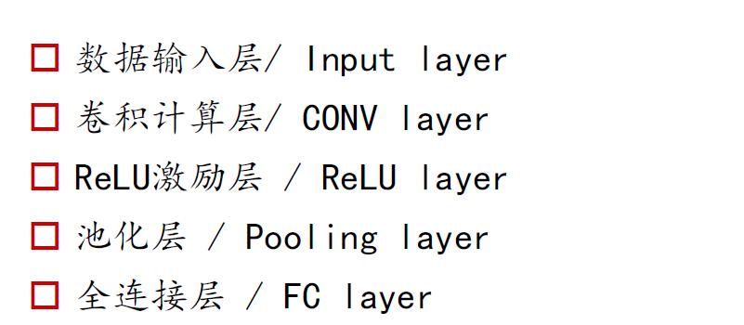
Convolutional neural network contains:

Slide 15
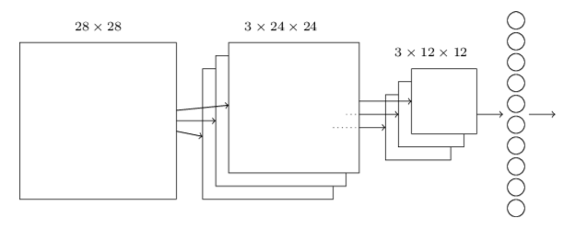
Input ➔ Conv + RELU ➔ Pooling ➔ FC➔Output

Slide 16
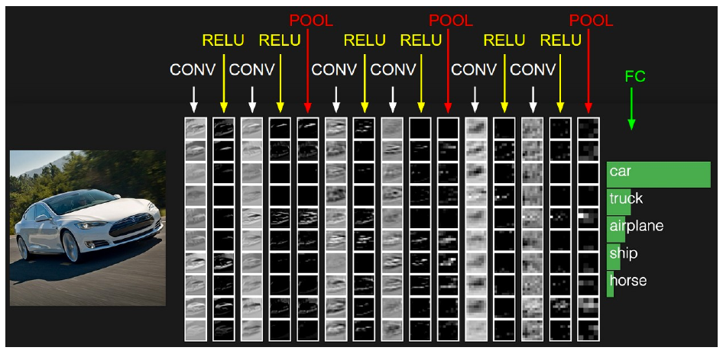

Slide 17
A Real Case
http://cs.stanford.edu/people/karpathy/convnetjs/
Using CNN to do image classification on CIFAR10 dataset.

